Slide 1

MULTIVARIATE STATISTICAL ANALYSIS 2
MINI PROJECT
Presenter:
Vaidehi Rane(21060641054)

Slide 2
TABLE OF CONTENTS
K-MEANS CLUSTERING ON ORIGINAL DATA
02
OBTAINING SIGNIFICANT VARIABLES AND CLUSTERING
01
Obtaining optimal value of k, forming k-clusters
Performing Analysis of variance for each variable treating clusters as populations
PCA ON ORIGINAL DATA
PCA ON DATA OBTAINED AFTER PERFORMING ANOVA
03
04
Computing scores of principal components, Clustering
Identifying principal components that are not useful in clustering

Slide 3
About Dataset
Geo-Magnetic field and WLAN dataset for indoor localization from wristband and smartphone Data Set.
The dataset contains 13 variables and 58374 observations.
Variables are as follows:
1: Timestamp of arrival on placeID, timestamp (Unixtime) of departure by placeID
2-4: Acceleration in three axes (x, y, z)
5-7: Magnetic field data for three axes (x, y, z) in micro-Teslas (uT)
8 – 10: Positions in three planes (x, y, z)
11 -13: Rotational speed of gyroscope in three directions (x, y, z)

Slide 4
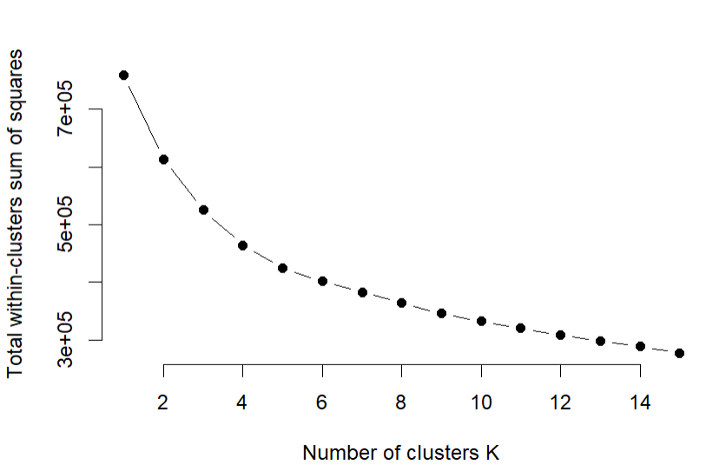

01
K-MEANS CLUSTERING ON ORIGINAL DATA
Elbow method is used for determining the optimal number of clusters
The basic idea behind Elbow method is to:
where Ck is the kth cluster
W(Ck) is the within-cluster variation.
The results suggest that 5 is the optimal number of clusters as it appears to be the bend in the knee (or elbow).

Slide 5

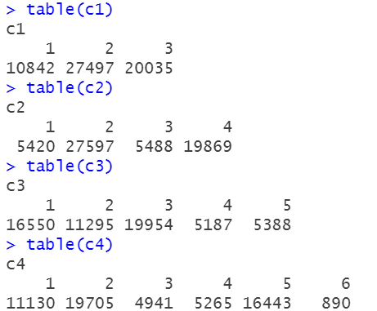
FOR DIFFERENT VALUE OF K
Different possible values of k which lie near the optimal value of k formed it into a table to show the number of observations in different clusters.
For K=3,4,5,6
For K=3
K=4
K=5
K=6

Slide 6
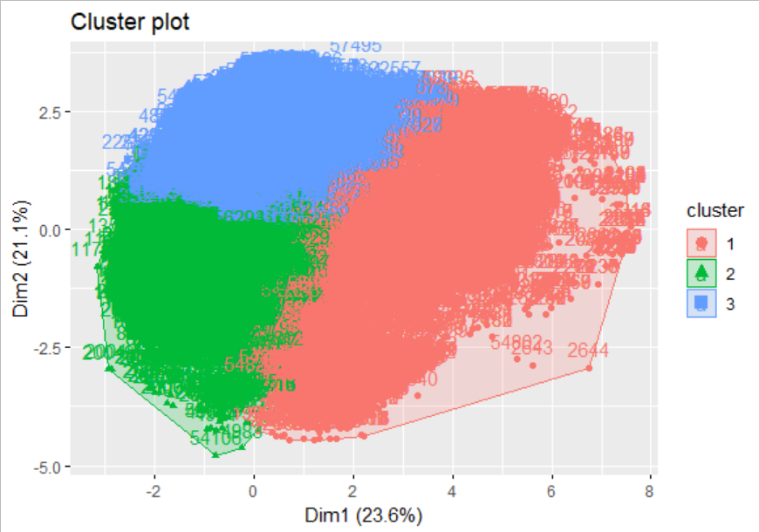
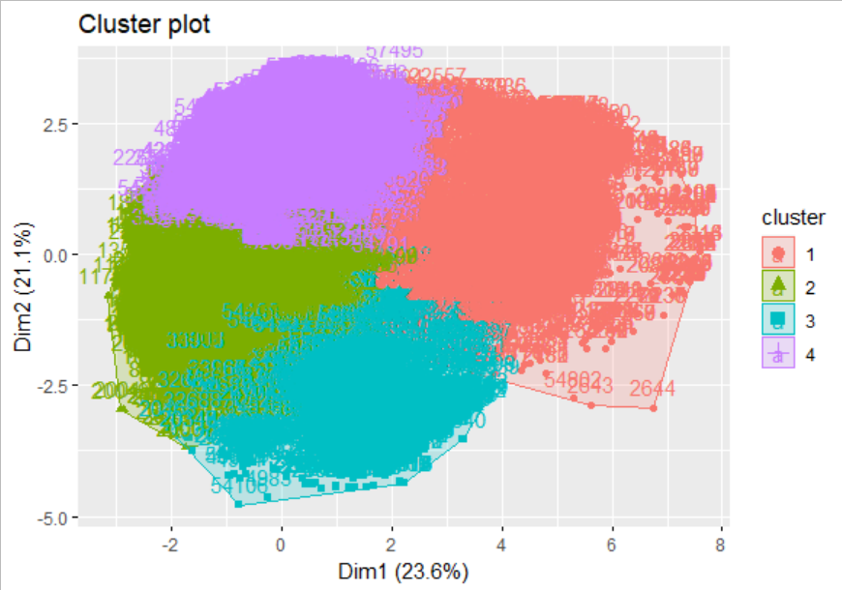
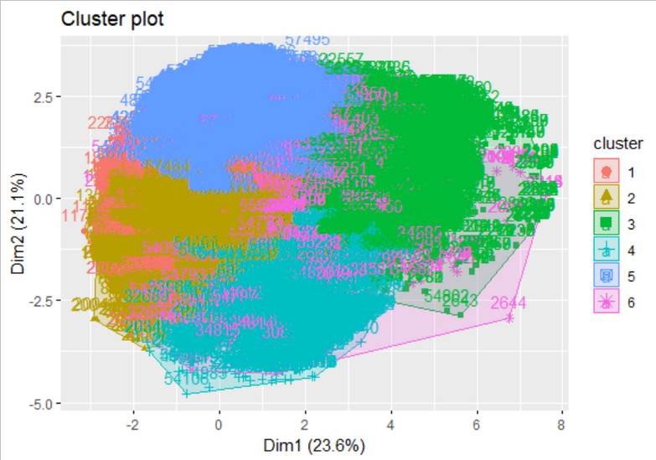
K=6
K=4
K=3

Slide 7
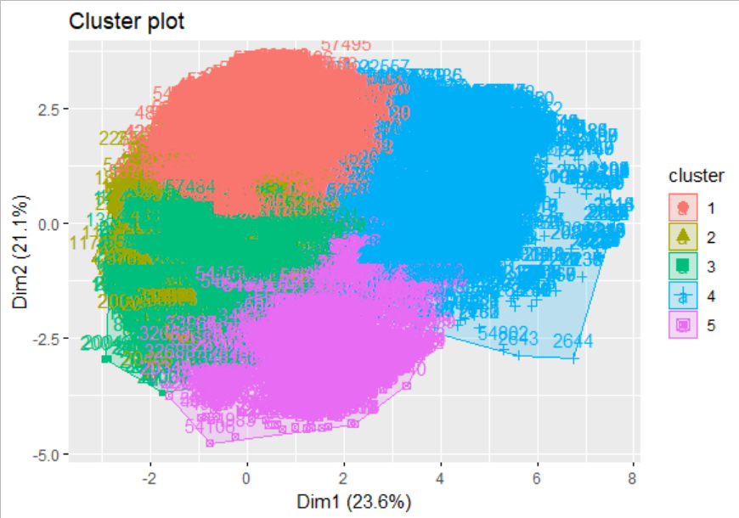
For K=5
Different Colors show that there are five clusters present and the points within the same color are the observations within that cluster respectively.
Points that are inside the same cluster are homogenous forming clusters

Slide 8
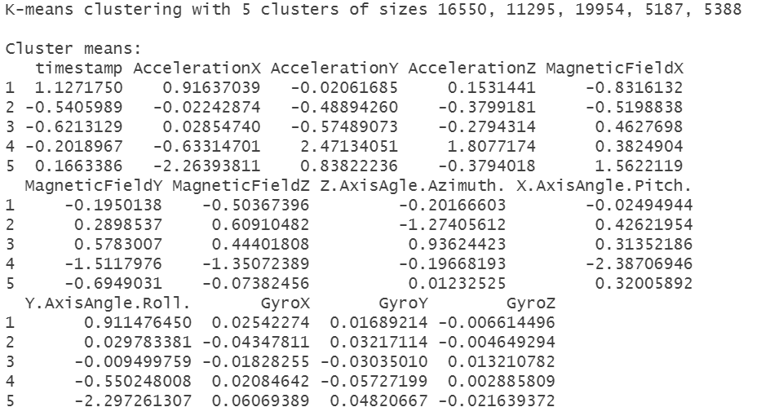
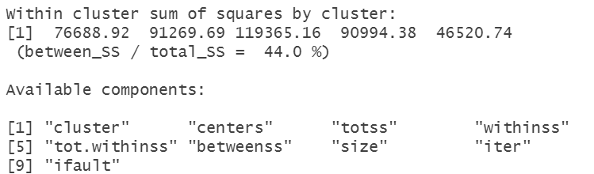
Result of k-means clustering on original data
And 44% is Between Sum of Square percentage

Slide 9
02
OBTAINING SIGNIFICANT VARIABLES AND CLUSTERING
We used the Analysis of variance method to remove the insignificant variables from considering the clusters as Population. One-way Anova technique is used for the original data as the response variable and cluster as the independent variable.
ANOVA
Analysis of variance for each variable treating clusters as populations.
Assumption
The responses for each factor level have a normal population distribution.
These distributions have the same variance.
The data points are independent.
Hypothesis
H₀ : All cluster means are equal
i.e. 𝝁₁ = 𝝁2
H₁ : At least one of the cluster mean is not equal
i.e. 𝝁₁ not equal to 𝝁₁

Slide 10
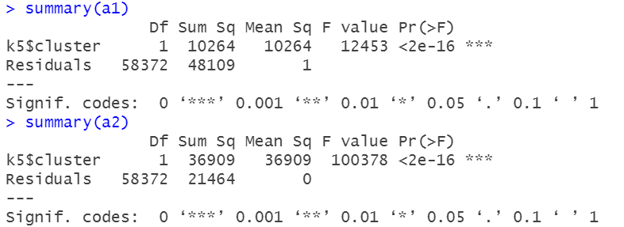
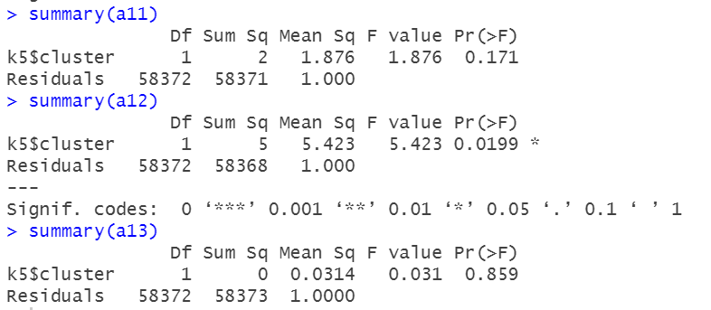
Here clusters are taken as the population for carrying out the analysis of variance.
From the output of the Anova the p-values are greater than the level of significance i.e. alpha = 0.05 i.e. 5% for the variables GyroX, GyroZ.
Therefore we do not Reject the null hypothesis
Here the variables GyroX, GyroZ are insignificant variables of the data for clustering.

Slide 11
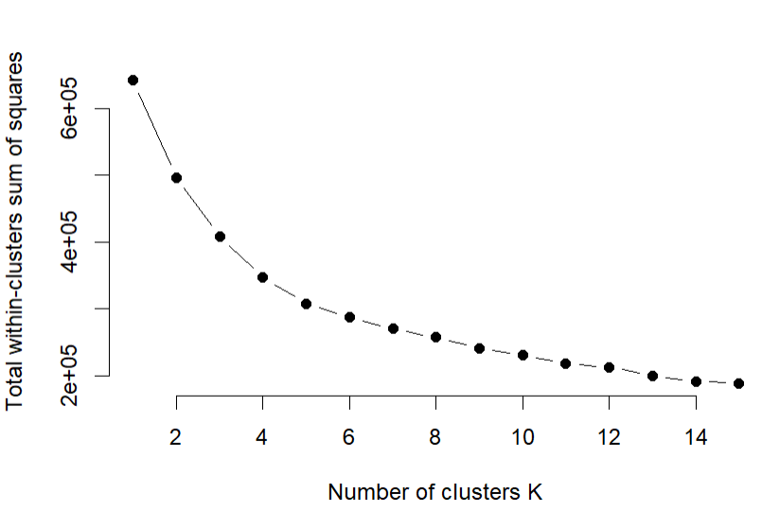

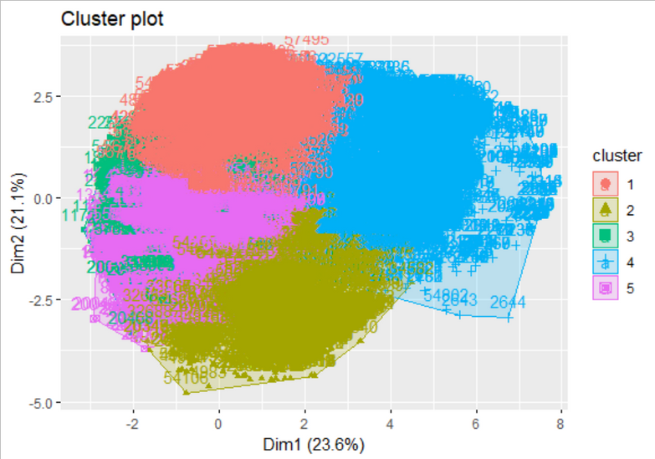
After obtaining data with significant variables using ANOVA,
Optimal values are formed into a table to show the number of observations in different clusters.
The results suggest that 5 is the optimal number of clusters as it appears to be the bend in the knee (or elbow).

Slide 12
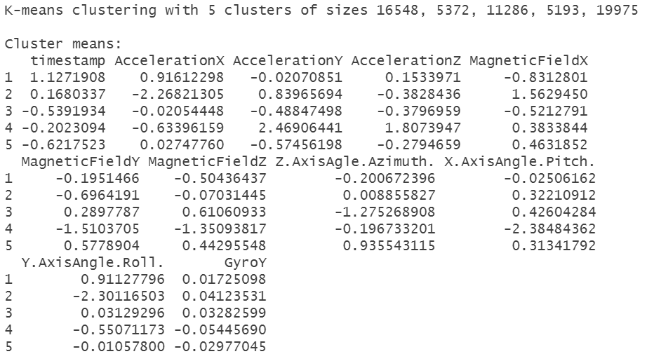
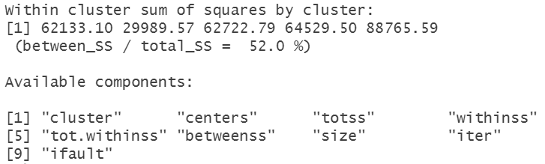
Result of k-means clustering on significant variables from the original data
And a 52% is Between Sum of Square percentage

Slide 13

COMPARISON
The observations in cluster 5 is increase and decreases in clusters 2, 3
This shows removing of the insignificant variables from the data impact the cluster 2,3 & 5
This can be interpreted that the insignificant variable's observation influence the between sum of squares.
Between_ss/total_ss represents the compactness of the clustering, that is, how similar are the members within the same group. If all the observations within a group were in the same exact point in the n-dimensional space, then we would achieve 100% of compactness.

Slide 14
Clusters on the Raw data(Set 1) | Clusters after removing insignificant variables(Set 2)
Between Sum of Square = 44% | Between Sum of Square = 52%
Hence, we can say that the data with significant variables after applying ANOVA shows more compactness that is the members within same group are more similar than the complete dataset.
We conclude that clustering is performed better on significant variables.

Slide 15
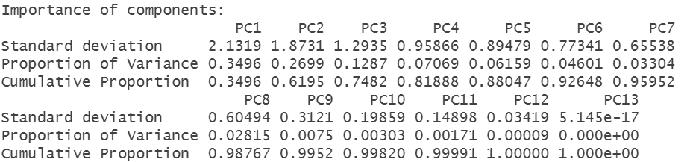
03
PCA ON ORIGINAL DATA
Principle component analysis is a dimension reduction technique. The principal components are the linear combinations of the original variables that account for the variance in the data.
d is a correlation matrix obtained from original dataset using following command
Using correlation matrix, eigen values and eigen vectors are obtained in order to find which components are important
No. of Principle components = No. of Variables = No. of dimensions = 13

Slide 16
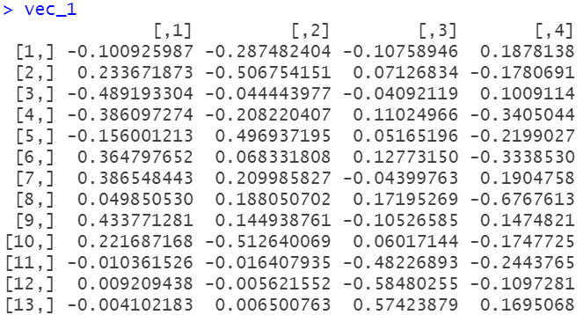
Eigen values:
Eigen values greater than 1
For Eigen values grater than unity, eigen vectors are obtained in order to compute PC scores

Slide 17
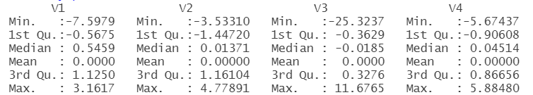
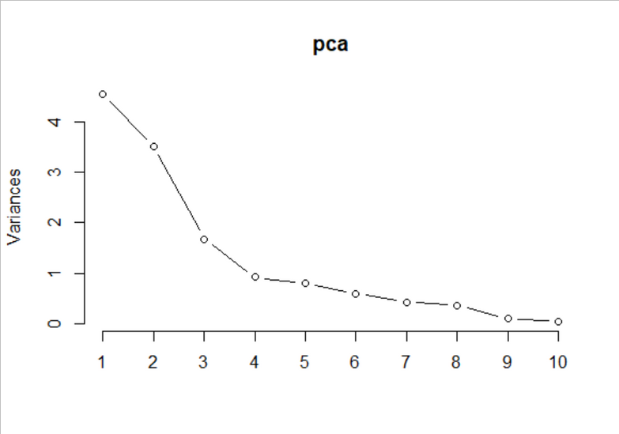
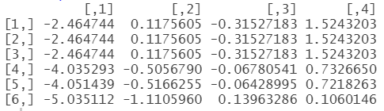
Summary of PC scores:
Screeplot :
Head of PCA dataset obtained:

Slide 18
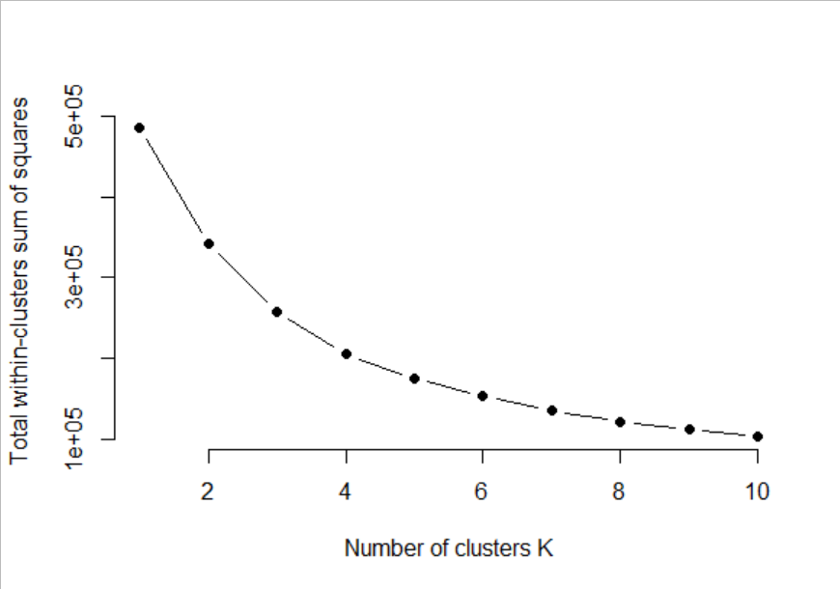

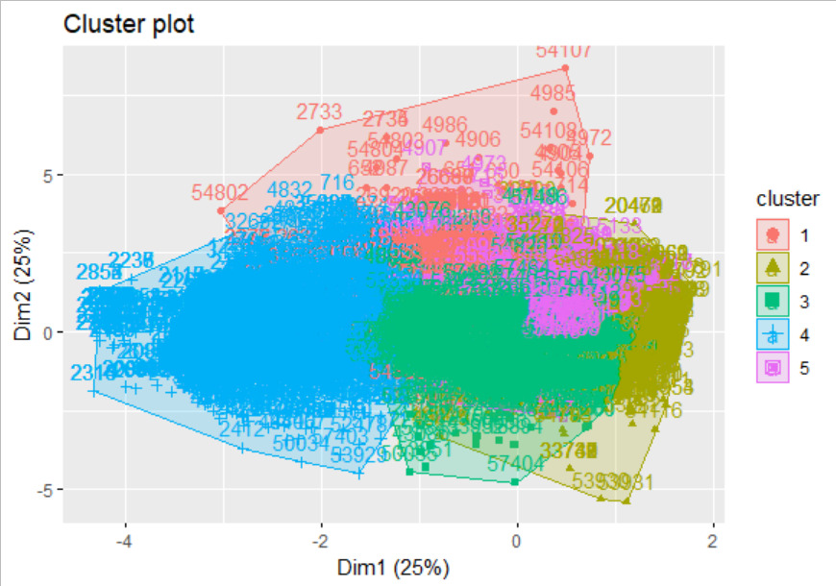
After obtaining PCA data from PC scores,
Optimal values of k formed into a table to show the number of observations in different clusters.
The results suggest that 5 is the optimal number of clusters as it appears to be the bend in the knee (or elbow).

Slide 19
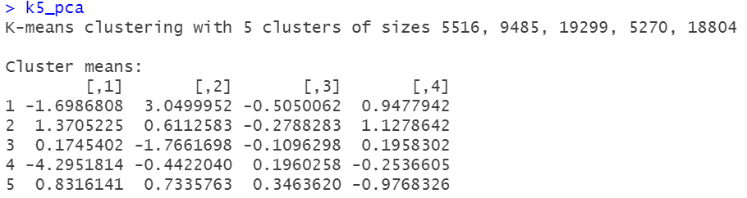
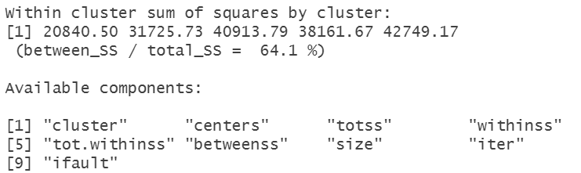
Result of k-means clustering on PCA data
And a 64.1% is Between Sum of Square percentage

Slide 20
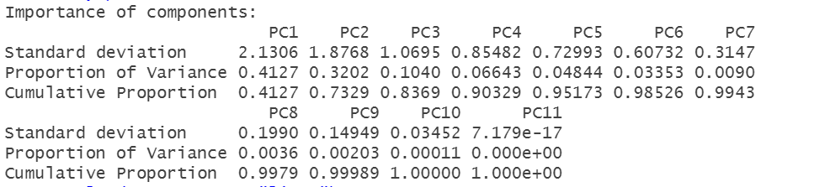
04
PCA ON DATA OBTAINED AFTER PERFORMING ANOVA
After performing Anova on the original data the insignificant variables are removed from the data and then we performed the PCA.
d is a correlation matrix obtained from original dataset using following command
Using correlation matrix, eigen values and eigen vectors are obtained in order to find which
components are important
No. of Principle components = No. of Variables = No. of dimensions = 11

Slide 21
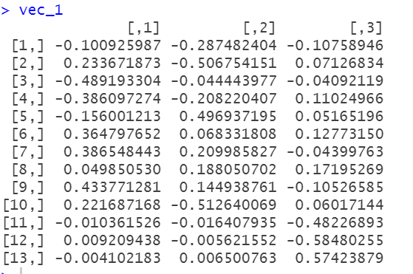
Eigen values:
Eigen values greater than 1
For Eigen values grater than unity, eigen vectors are obtained in order to compute PC scores

Slide 22
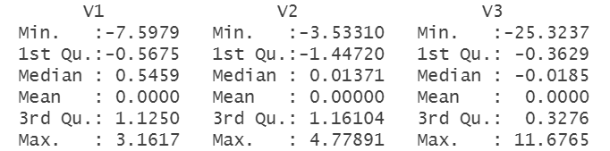
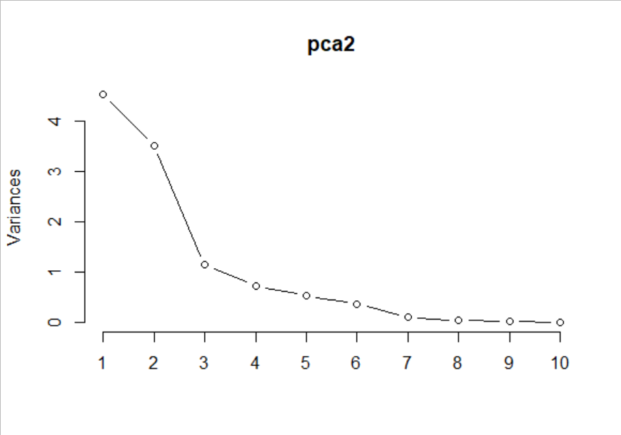
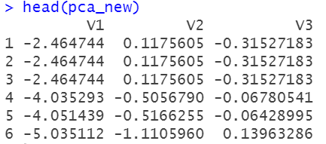
Summary of PC scores:
Screeplot::
Head of PCA dataset obtained:

Slide 23
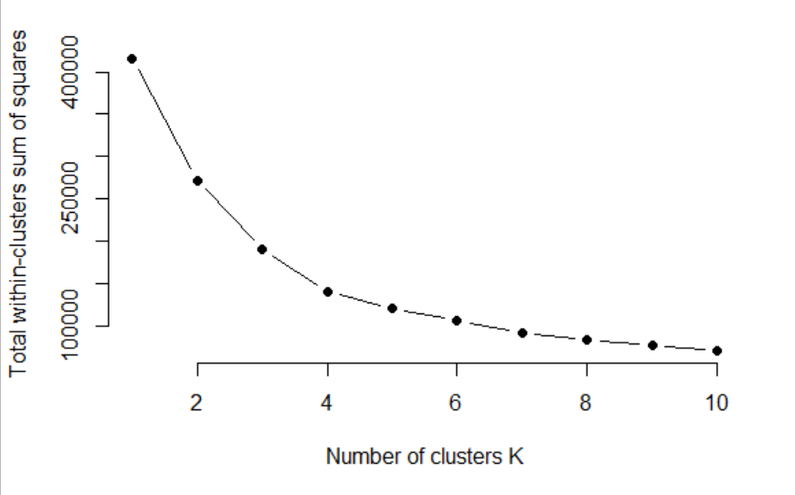


After obtaining PCA data from PC scores from significant variables,,
Optimal values are formed into a table to show the number of observations in different clusters.
The results suggest that 5 is the optimal number of clusters as it appears to be the bend in the knee (or elbow).

Slide 24
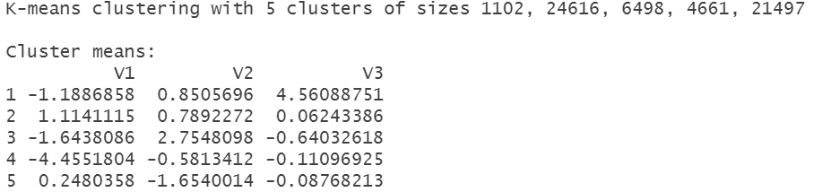
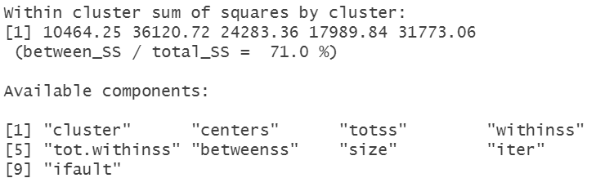
Result of k-means clustering after removing insignificant variables and performing PCA
And a 71% is Between Sum of Square percentage

Slide 25
ANOVA ON PCA DATASET
Analysis of variance for each variable treating clusters as populations.
Assumption
The responses for each factor level have a normal population distribution.
These distributions have the same variance.
The data are independent.
Hypothesis
H₀ : All cluster means are equal
i.e. 𝝁₁ = 𝝁2
H₁ : At least one of the cluster mean is not equal
i.e. 𝝁₁ not equal to 𝝁₁

Slide 26
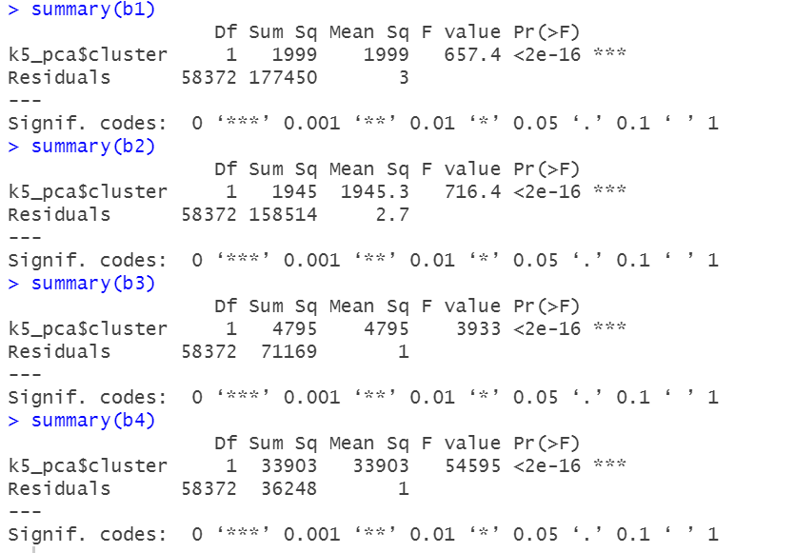
From the output of the Anova the p values of all the variables is less than 0.05
Therefore we Reject the null hypothesis
Due to this, all principle components are significant to be considered for clustering.

Slide 27

COMPARISON
The observations in cluster 2, 5 is increase and decreases in clusters 1, 3, 4
This shows the removing of the insignificant variables from the data impact the cluster 2,3 & 5
This can be interpreted that the insignificant variable's observation influence the between sum of square.
Clusters on the PCA | Clusters after removing insignificant variables from the original data and performing pca
Between Sum of Square = 64% | Between Sum of Square = 71%
PCA data with significant variables after applying ANOVA shows more compactness that is the members within same group are more similar than the PCA dataset.

Slide 28
COMPARISON
Clusters on the Raw data(Set 1) | Clusters after removing insignificant variables(Set 2)
Between Sum of Square = 44% | Between Sum of Square = 52%
Clusters on the Raw data(Set 3) | Clusters after removing insignificant variables and performing PCA (Set 4)
Between Sum of Square = 64% | Between Sum of Square = 71%

Slide 29

CONCLUSION
Compactness of 3rd and 4th cluster 64% and 71% is higher than 1st and 2nd as it is 44% and 52% respectively, so we can say that PCA technique on significant variables gives us more accurate results in comparison of compactness.
We conclude that clustering is performed better on significant variables after applying PCA.
Thank you!

